Slide 1
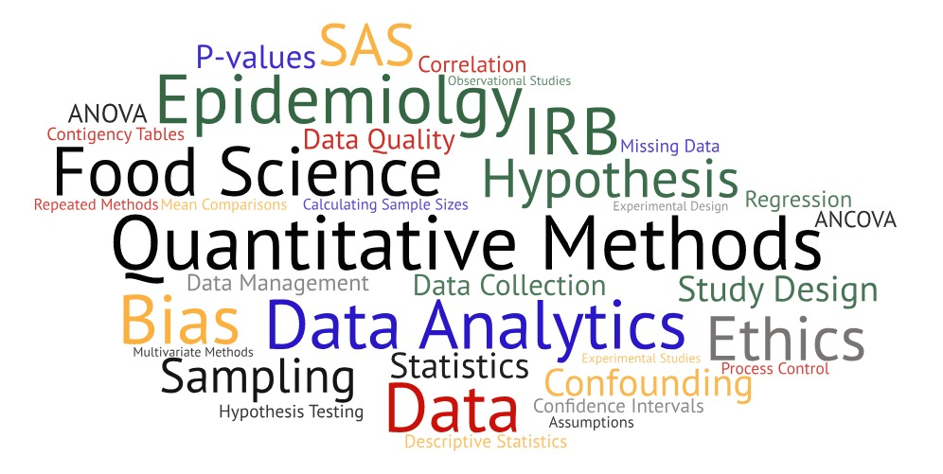
One Health Summer Institute Introduction to Data Analytics, Statistics & Programming in Epidemiologic Research

Slide 2
Statistical Concepts

Slide 3

What is Statistics?
Statistics is the science of learning from data, and of measuring, controlling and communicating uncertainty. – American Statistical Association
Statistics is a science, not a branch of mathematics, but uses mathematical models as an essential tool. – John Tukey
Epidemiology relies heavily on statistics.

Slide 4
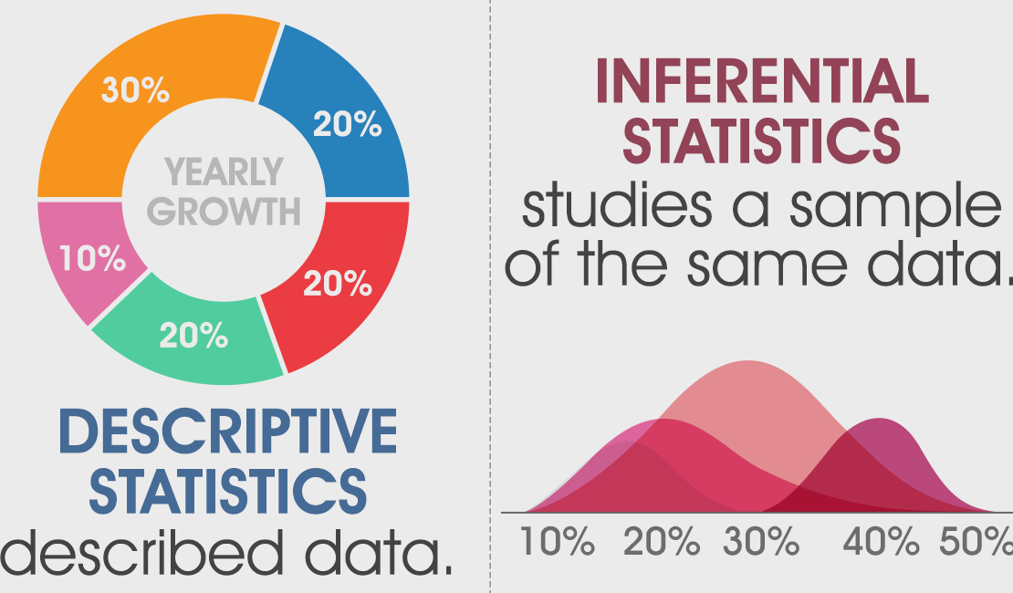
Branches of Statistics
Descriptive statistics are methods for organizing and summarizing data.
Inferential statistics are methods for using sample data to make general conclusions (inferences) about populations.

Slide 5
Populations and Samples
A population is the collection of all outcomes, responses, measurement, or counts that are of interest.
A sample is a subset of a population.
Population
Sample

Slide 6
Parameters and Statistics
A parameter is a characteristic of a population.
Value is typically unknown
Usually difficult or impossible to calculate
A statistic is a characteristic of a sample.
Used to make inferences about population parameters
Often referred to as an estimator
Parameter
Population
Statistic
Sample

Slide 7
Parameter or Statistic?
Example 1:
Average weight of product produced by an establishment in a month
Average weight of 500 product units from that month’s production
Example 2:
Average weekly income for 450 college students
Average weekly income for all students

Slide 8
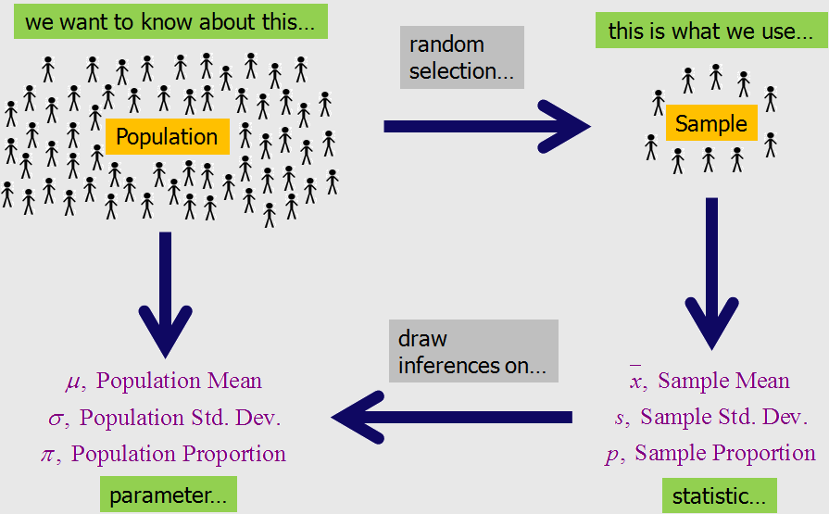
The Goal of Inferential Statistics

Slide 9
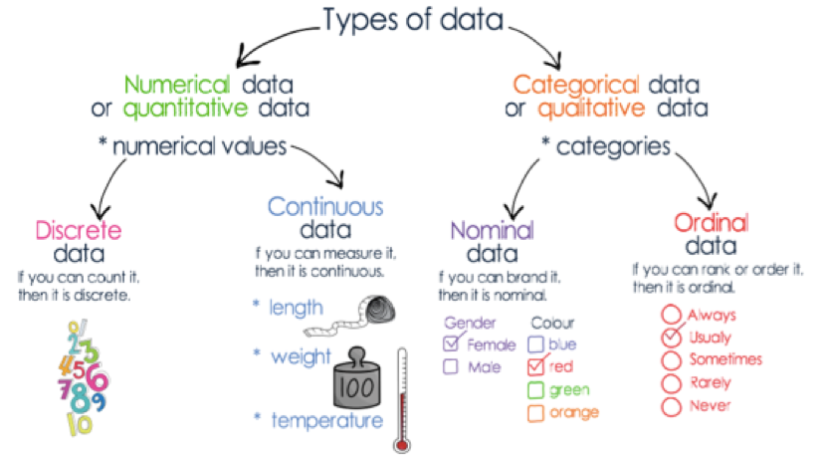
Types of Data

Slide 10
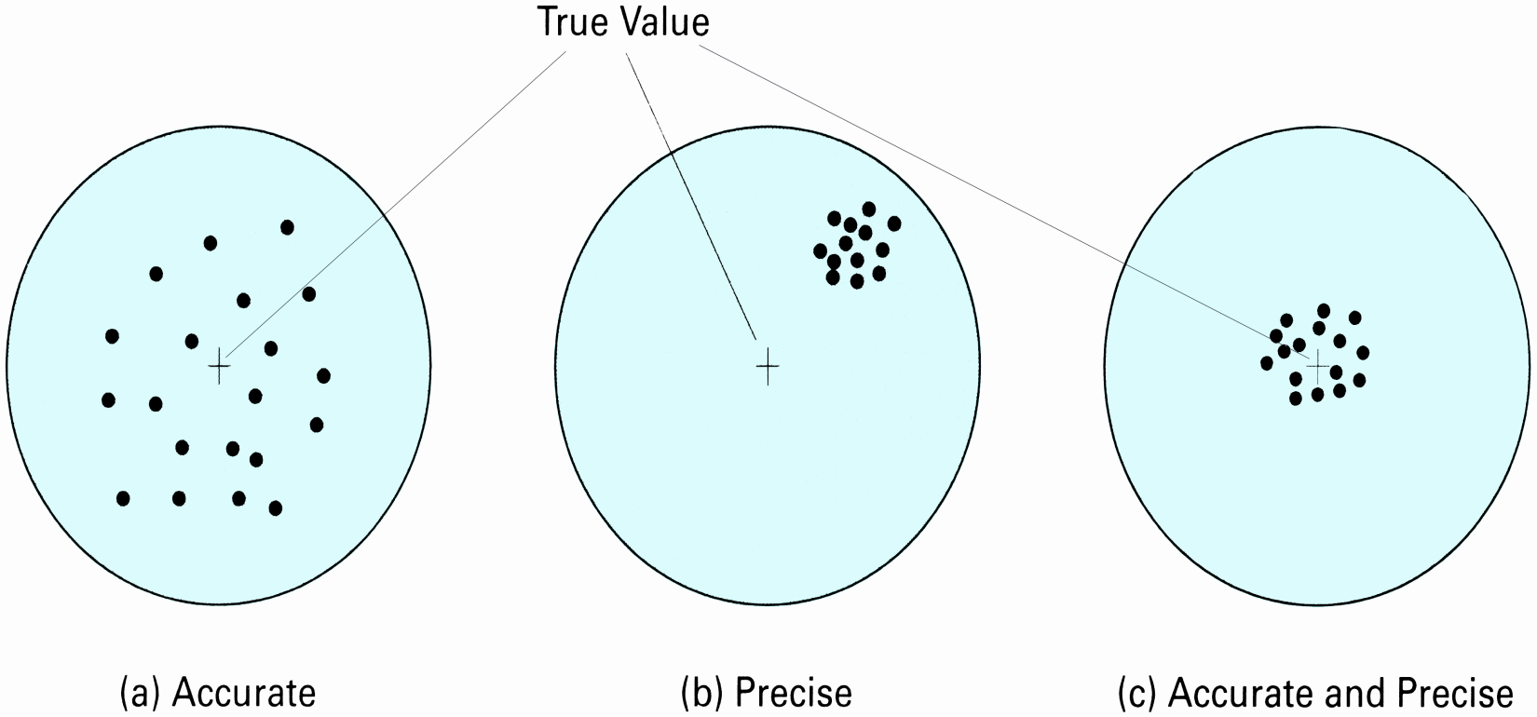
Precision and Accuracy
Precision is how reproducible a measurement value is.
Accuracy is how close a measured value is to its “true” value.

Slide 11
Variables
Variable – numerical description of the outcome of an experiment
Independent variable – changed or controlled in a scientific experiment to test the effects on the dependent variable
Dependent variable – variable being tested and measured in a scientific experiment
Categorical (discrete) – contains values indicating membership in categories; finite (or countable) set of real numbers for range
Binary (dichotomous) – only has two categories
Nominal – two or more categories that do not have an order
Ordinal – ordered or ranked categories
Continuous (interval) – infinite number of values for range
Interval – difference between measurements can be calculated but no true zero
Ratio – same as interval but there is a true zero

Slide 12
Scales of Measurement
Nominal
Interval
Ratio
Ordinal
Categories (no ordering or direction)
Uses names, labels, qualities
Examples: marital status, type of car, books
Ordered Categories (rankings, order, scaling)
Differences in data are not meaningful
Examples: Quality rating, student grades, top 10 list
Differences between measurements (no true zero)
Differences can be calculated
Examples: Temperature, years on timeline
Differences between measurements (true zero)
Ratio of two values can be formed
Examples: Height, age, grade point average

Slide 13
Summary of Scales of Measurement
Scale of measurement
Put data in categories
Arrange data in order
Subtract data values
Determine if one data value is a multiple of another
Nominal
Yes
No
No
No
Ordinal
Yes
Yes
No
No
Interval
Yes
Yes
Yes
No
Ratio
Yes
Yes
Yes
Yes

Slide 14
What is a distribution?
A distribution characterizes possible values that a random variable may assume along with the probability of assuming these values.
Probability is the likelihood that the event will occur.
Two Conditions:
Value is between 0 and 1.
Sum of the probabilities of all events must be 1.

Slide 15
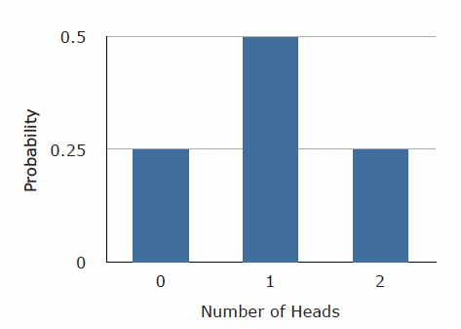
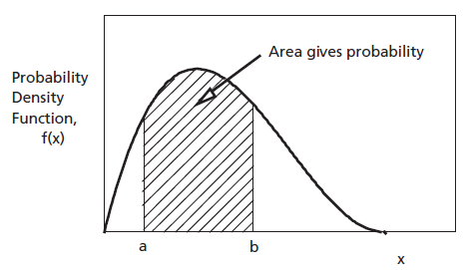
Types of Distributions
Discrete distributions are constructed from discrete random variables.
Continuous distributions are based on continuous random variables.

Slide 16
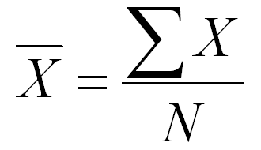
Measures of Central Tendency
Mean
Arithmetic average
Add up all the values and divide by number of values
Influenced by extreme values
Less reliable for smaller sample sizes
Median
Midpoint of data, value that splits data into two halves
Also known as 50th percentile
Order data from least to greatest and find middle number
If even number of samples, median is mean of two middle numbers
Mode
Most common data value
If no value is repeated, then there is no mode

Slide 17
Measures of Dispersion
Describe spread of data
Measures variability of items themselves
Measures variability around measure of central tendency
Range
Difference between largest value – smallest value
Fairly insensitive so not often used
Variance
Mean of the squared deviation from the mean
Larger variance, more scores deviate from the mean
Standard deviation
Most common measure of variation
Measures variation around measure of central tendency
Square root of the variance
Coefficient of Variation
Measures standard deviation relative to mean (expressed as %)
Used to compare samples measured in different units

Slide 18
Common Distributions
Discrete:
Bernoulli
Binomial
Poisson
Negative Binomial
Geometric
Hyper-Geometric
Continuous:
Normal
Log-normal
Uniform
Triangular
Exponential
Gamma
Beta

Slide 19
Binomial Distribution
Discrete distribution constructed by determining the probabilities of X successes in n Bernoulli trials.
Bernoulli trials
Only 2 possible outcomes (success, failure)
Probability of success (p) does not change from trial to trial
Trials are independent
Normal approximation when:
Number of experiments (sample size) is large
Probability of success close to 0.5
Examples
Number of heads or tails in sequence of coin flips
Vote counts for two candidates in an election

Slide 20
Poisson Distribution
Discrete distribution of counts of events per interval.
Each event is independent of any other event.
Number of events in each interval can vary from zero to infinity.
Probability of event in an interval is stable
Often used to model rare events
Examples
Number of customers in an hour
Daily number of accidents on stretch of highway
Number of typos in a book

Slide 21
Other Discrete Distributions
Negative Binomial Distribution
Bernoulli trials repeated independently until fixed number of successes (k) has occurred
X = trial on which k^{th} success occurs
Geometric Distribution
Bernoulli trials repeated independently until 1st success occurs
X = trial on which 1st success occurs
Hyper-Geometric Distribution
Similar to Binomial
X = number of successes in n trials
Sampling is done without replacement
Trials are not independent

Slide 22
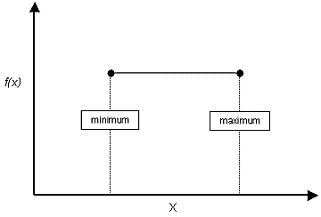
Uniform Distribution
Equally likely probability of values between a maximum and a minimum
Mean = (b+a)/2
Variance = (b-a)²/12
‘a’ is a location parameter
‘b-a’ is a scale parameter
No shape parameter

Slide 23
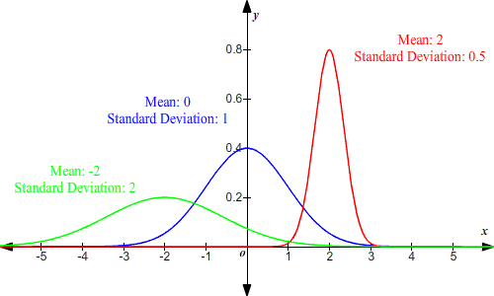
Normal Distribution
Most important distribution
Frequently called Gaussian distribution
“Bell Shaped”, symmetrical around mean
Mean, median and mode are equal (mean is best)

Slide 24
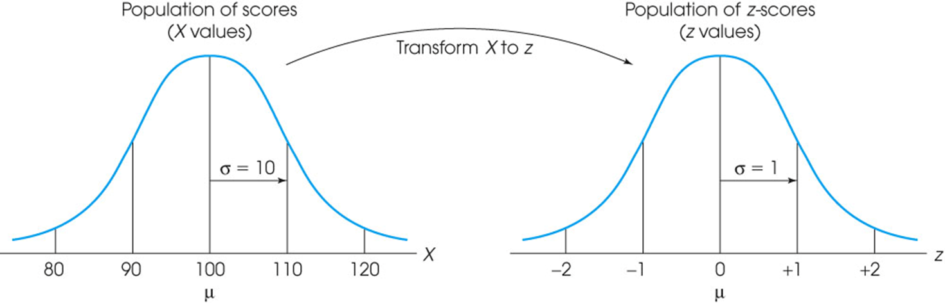
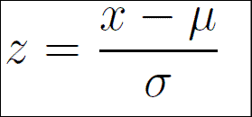
Standard Normal Distribution
Normal distribution with mean of zero and standard deviation of 1
Sometimes it is helpful to be able to know where the values is located relative to the mean and/or relative to other values
Z-scores
Sign indicates if value is located above (+) or below (-) the mean
Corresponds to number of standard deviations from the mean

Slide 25
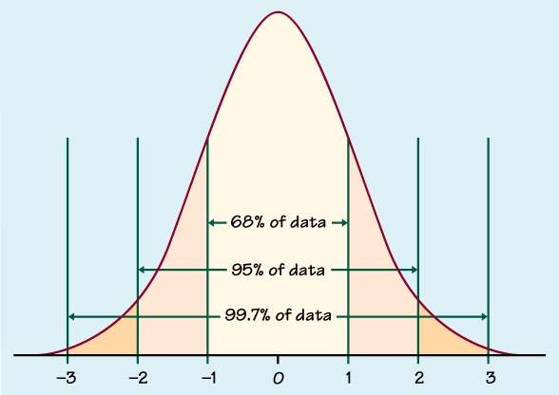
The Empirical Rule

Slide 26
Properties of the Normal Distribution
Sum of two normal random variables also follows normal distribution
Linear transformations of normal random variables also result in normal random variables

Slide 27
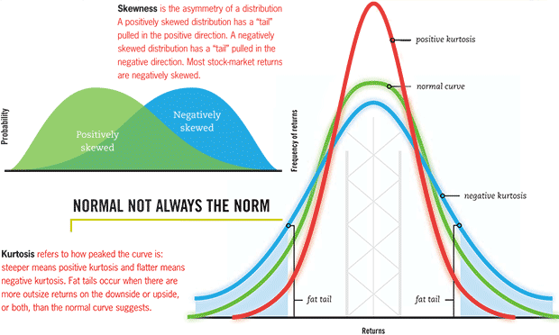
Variations of Normal Distribution

Slide 28
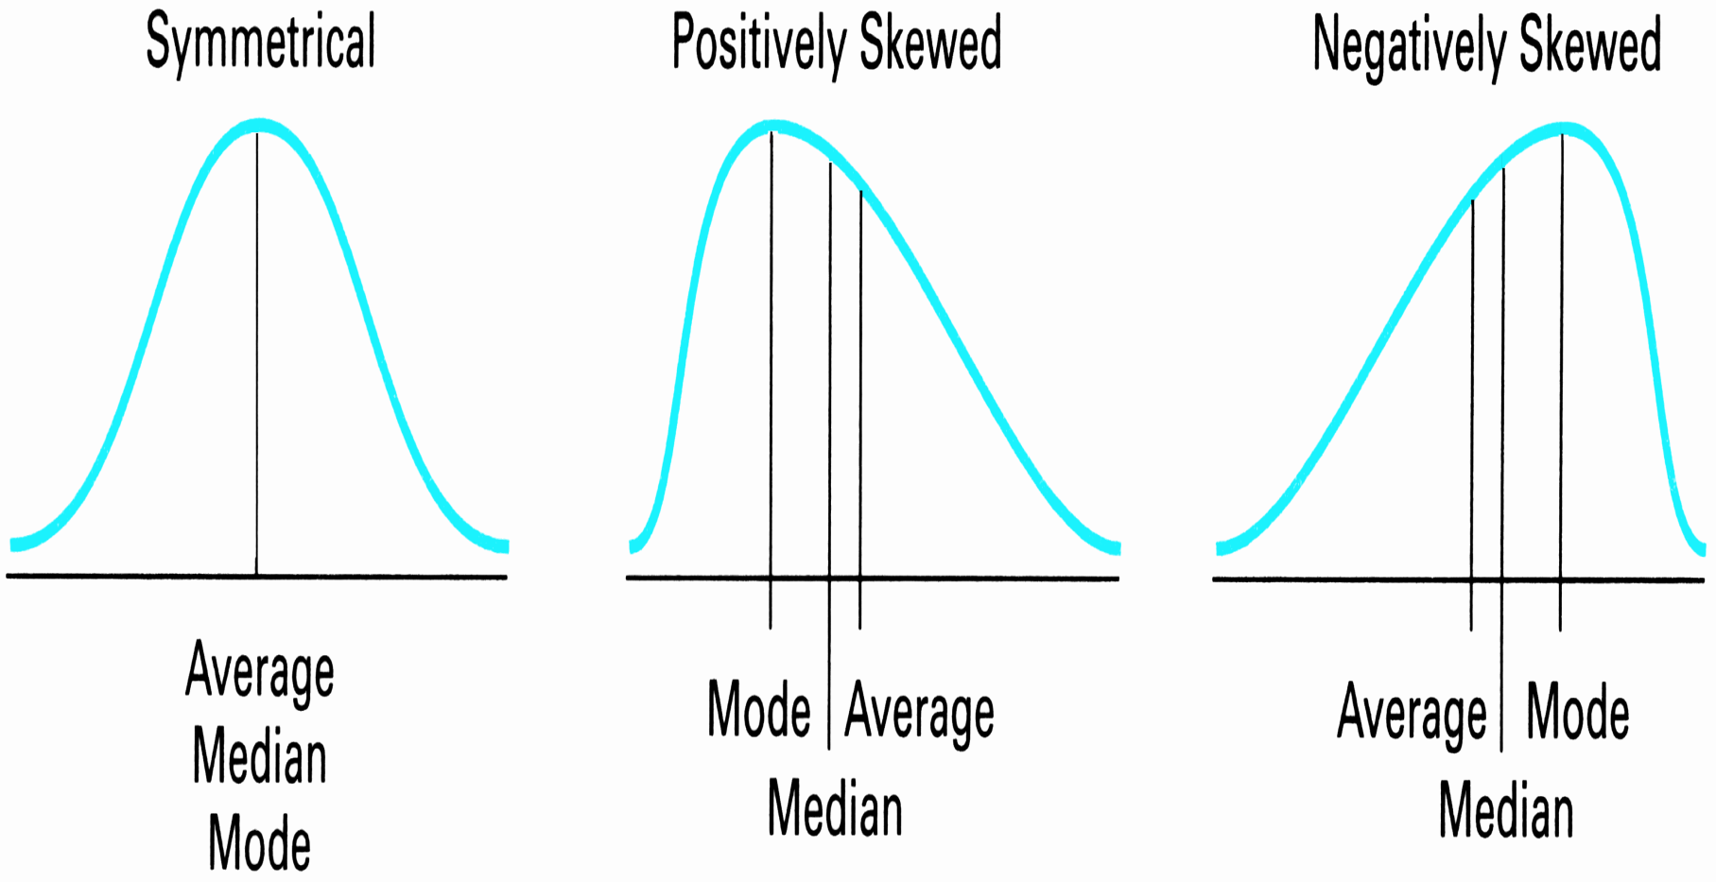
Relationship Among Measures of Central Tendency

Slide 29
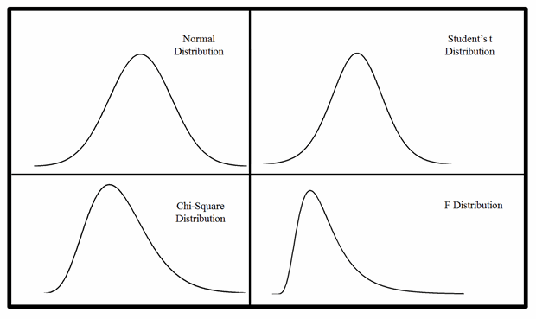
“Children” of the Normal Distribution

Slide 30
“Children” of the Normal Distribution
Chi-square (χ²) distribution
Often used as measure of goodness-of-fit
Square of standard normal random variable
Student’s t distribution
Use when sample size is small (<30)
Approaches standard normal as number of degrees of freedom increases
F distribution
Used to compare variances of two populations
Ratio of two chi-square random variables
Positively skewed, values > 0

Slide 31
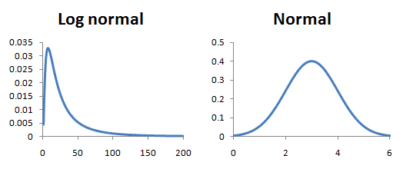
Log-Normal Distribution
Variation of normal distribution
Positively skewed
Used for things which have normal distributions with only positive values

Slide 32
Exponential Distribution
Exponential distribution models time between successive events
Memoryless: current time has no effect on future outcomes
Gamma distribution models series of independently and identically distributed random exponential variables
Beta distribution models proportional ratio of two gamma distributed random variables
Useful for modeling uncertainty about a probability or percentage.
Expresses uncertainty on a [0,1] bounded quantity.

Slide 33
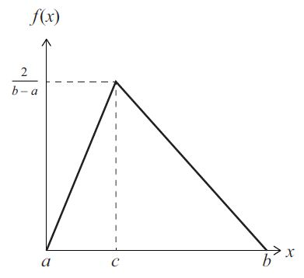
Triangular Distribution
Often used when only range and a best guess are available.
Parameters: Minimum a, maximum b, most likely c
Symmetric or skewed in either direction
Used as rough approximation of other distributions

Slide 34
Summary
Various parametric distributions
Choice of parametric distribution usually driven by:
Continuous vs. discrete
Tails or bounded
Broad shape
Type of information easily estimated

Slide 35
Central Limit Theorem

Slide 36
Central Limit Theorem (CLT)
Normal distribution is related to most distributions through CLT.
CLT states that sampling distribution of the mean of any independent, random variable will be normal or nearly normal if the sample size is large enough.
How large is large?
If sample population is normal, distribution will be normal no matter the sample size
If sample population is symmetrical, distribution becomes approximately normal for small samples sizes
If sample population is skewed, distribution becomes approximately normal for sample sizes > 30
Greater the sample size, better the approximation.

Slide 37
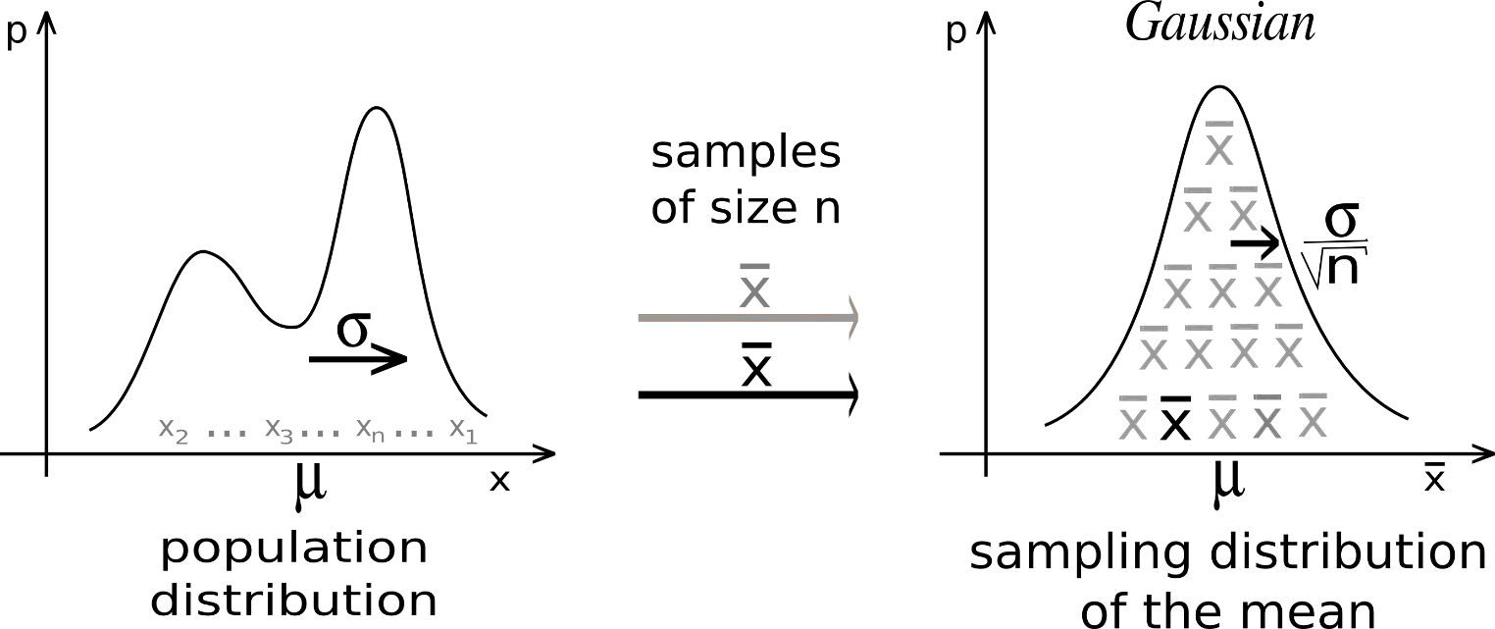
Central Limit Theorem
For almost all populations, sample mean is approximately normally distributed and equal to mean of population.
Standard deviation can be obtained by dividing population standard deviation by square root of sample size.

Slide 38
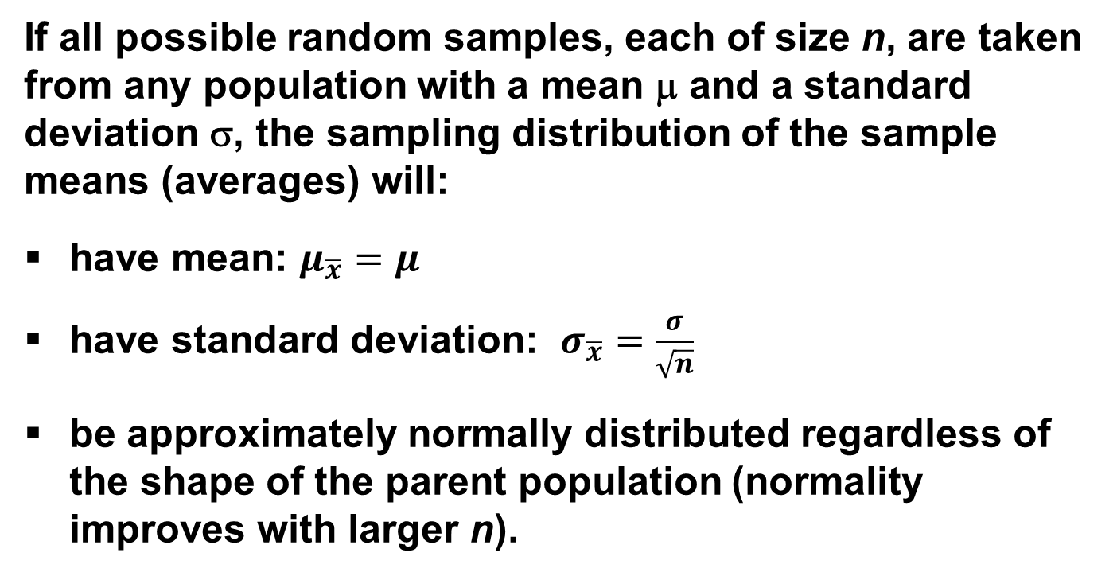
Mathematical Theory for CLT
If all possible random samples, each of size n, are taken from any population with a mean μ and a standard deviation σ, the sampling distribution of the sample means (averages) will:
have mean: $μ_{\overline{x}}=μ$
have standard deviation: $σ_{\overline{x}}=\frac{σ}{\sqrt{n}}$
be approximately normally distributed regardless of the shape of the parent population (normality improves with larger n).
Notes:
It turns out that if you were to go out and sample many, many times, most sample statistics that you could calculate would follow a normal distribution.
What are the 2 parameters (from last time) that define any normal distribution?
Remember that a normal curve is characterized by two parameters, a mean and a variability (SD)
What do you think the mean value of a sample statistic would be? The standard deviation?
Remember standard deviation is natural variability of the population
Standard error can be standard error of the mean or standard error of the odds ratio or standard error of the difference of 2 means, etc. The standard error of any sample statistic.

Slide 39
Mathematical Proof
If X is a random variable from any distribution with known mean, E(x), and variance, Var(x), then the expected value and variance of the average of n observations of X is:

Slide 40
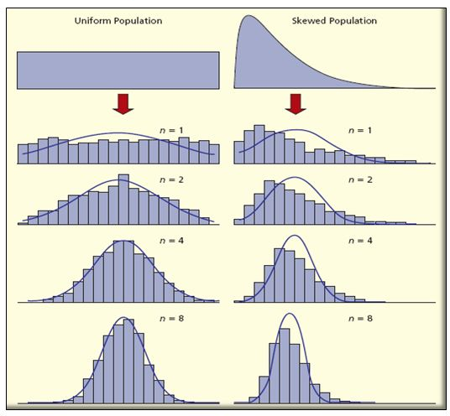
Visualize Central Limit Theorem

Slide 41
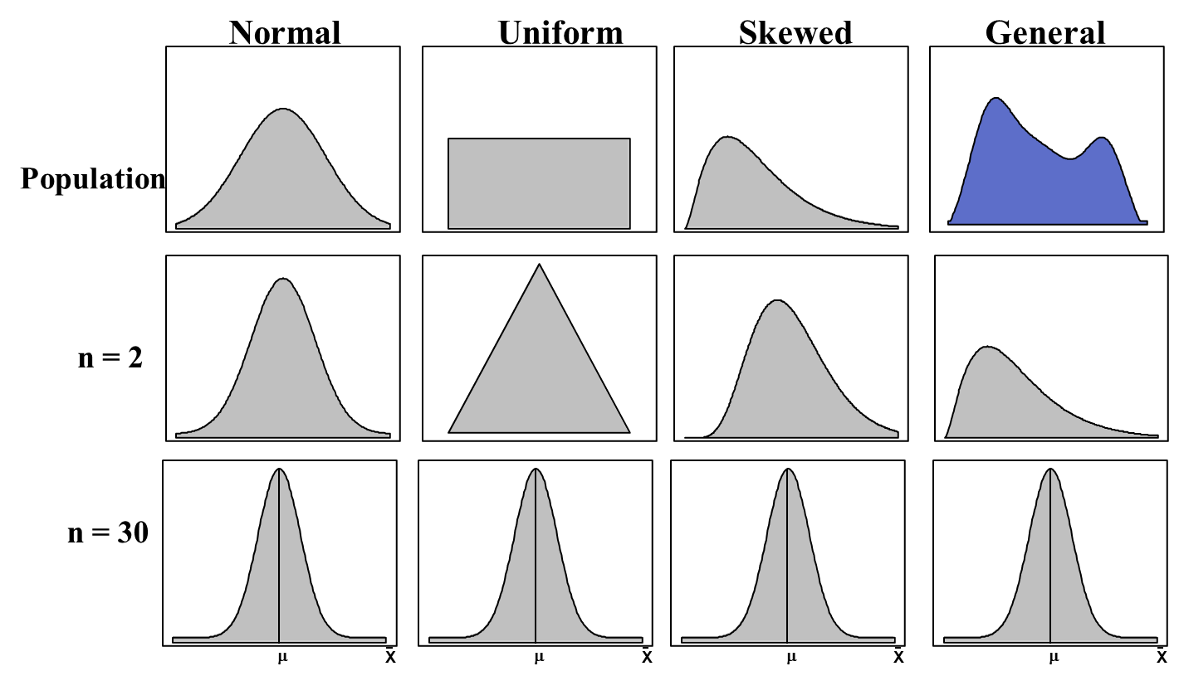
CLT Applies to Any Population

Slide 42
Try It!
Pick any probability distribution and specify a mean and standard deviation.
Randomly generate 1000 observations from that probability distribution.
Plot “observed” values in a histogram.
Randomly generate 1000 averages-of-2 (randomly pick 2 and take their average) from that probability distribution.
Plot “observed” averages in histograms.
Repeat for averages-of-10, and averages-of-100.
Notes:
IF the true mean was 128 with an average variability of 15 lbs….

Slide 43
Hypothesis Testing, Confidence Intervals and Calculating Sample Sizes

Slide 44
Types of Research Questions
Descriptive
Describes phenomena or characteristics of a group being studied
Answers “what is”
Relationship
Investigates extent of relationship between variables
Does not establish “cause-and-effect”
Difference
Makes comparisons between or within groups of interest
Often associated with experimental research
Is there a difference between the control group and the experimental group?

Slide 45
Thought Process
Research Question
What overarching question are you trying to answer?
Hypothesis
Individually testable components that, together, answer your research question
Rationale and Significance
Why is it necessary to be performing this work? What will be the application or purpose of your results?

Slide 46
Notation
A directional hypothesis is one in which the researcher indicates the specific direction that he or she expects will emerge in a relationship in the study.
Notation: H₀: µ₁ < µ₂ H₁: µ₁ > µ₂
A non-directional hypothesis is when there is no specific prediction about what direction the outcome of a study will take.
Notation: H₀: µ₁ = µ₂ H₁: µ₁ ≠ µ₂

Slide 47
Hypothesis – Example 1
Adjusting carbonation level, amount of syrup, and transportation container for Coca-Cola fountain drinks makes McDonald’s Coca-Cola better tasting than Burger King’s.
What questions are being asked?
Does carbonation level affect taste?
Does amount of syrup affect taste?
Does transportation container affect taste?
Do people prefer McDonald’s Coca-Cola over Burger King?
How can we develop a testable hypothesis?
What would be the rationale for determining this?
Could we get IRB approval for this study?

Slide 48
Hypothesis – Example 2
Pasteurization of milk improves its safety while decreasing its “flavor” and acceptability among individuals living in rural settings.
What questions are being asked?
Does pasteurization improve the safety of milk?
Does pasteurization result in different flavor profiles?
Do individuals living in rural settings have a greater preference for milk that is NOT pasteurized than those living in urban settings?
How can we develop a testable hypothesis?
What would be the rationale for determining this?
Could we get IRB approval for this study?

Slide 49
Hypothesis Testing

Slide 50
Types of Hypotheses
Research Hypotheses
Statistical Hypotheses
Mathematical, or logical statements that help researchers interpret the results of research

Slide 51
Hypothesis Testing
Goal: Make statement(s) regarding unknown population parameter values based on sample data.
Hypotheses can:
Estimate population characteristics
Correlate variables
Display differences among two or more populations
Show possible cause and effect
General goal of hypothesis test is to rule out chance (sampling error) as plausible explanation for results from research study.

Slide 52
Goal of Hypothesis Testing
Purpose of hypothesis test is to decide between two explanations:
Difference between sample and population can be explained by sampling error (there does not appear to be effect)
Difference between sample and population is too large to be explained by sampling error (there does appear to be effect).

Slide 53
Elements of a Hypothesis Test
Null hypothesis – statement regarding value(s) of unknown parameter(s).
Typically will imply no association between explanatory and response variables (will always contain an equality)
Alternative hypothesis – statement contradictory to the null hypothesis (will always contain an inequality)
Test statistic – quantity based on sample data and null hypothesis used to test between null and alternative
Rejection region – values of test statistic for which we reject the null in favor of the alternative hypothesis

Slide 54
Null and Alternative Hypotheses
Null hypothesis, H₀, always states that the treatment has no effect (no change, no difference).
H₀: μ₁-μ₂ = 0
Alternative hypothesis, H_{a}, states that the treatment has effect.
Two-sided test: H_{A}: μ₁-μ₂ ≠ 0
One-sided (directional) test: H_{A}: μ₁-μ₂ > 0
H_{A}: μ₁-μ₂ < 0

Slide 55
Important!
We don’t prove the null hypothesis.
Failure to reject null hypothesis cannot be interpreted as proof that no differences or relationships exist.
Existing differences or relationships might be obscured by:
insensitive outcome measures (the wrong fishnet),
inappropriate statistical designs,
poor sampling strategies, and
low statistical power.

Slide 56
Test Statistic
Test Statistic = $\frac{Sample Statistic −Hypothesized Value}{Standard Error of the Sample Statistic}$
Can use variety of statistical procedures to test null hypotheses.
Choice of which procedure used depends on a variety of factors including:
Research hypothesis
Data
Sampling strategy
What we want to be able to say as result of testing

Slide 57
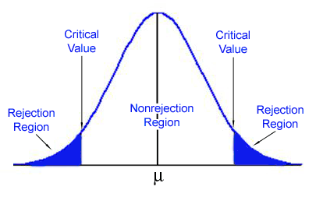
Rejection Region
Consists of outcomes that are very unlikely to occur if the null hypothesis is true.
Set of values of test statistic that are consistent with H_{A}, such that probability it falls in this region when H₀ is true is α.
Sometimes called critical region.

Slide 58
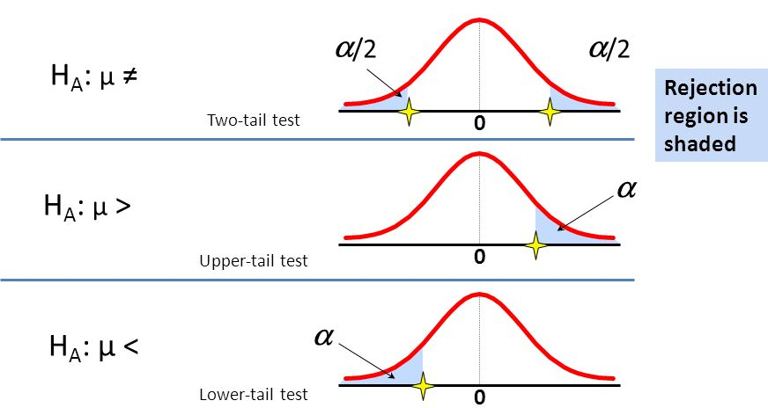
One-Tailed vs Two-Tailed Tests

Slide 59
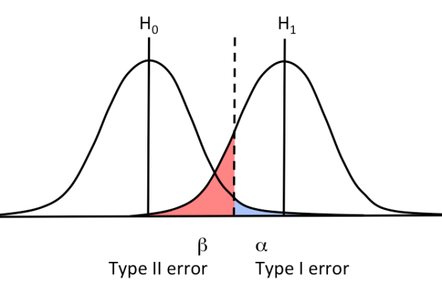
Errors in Hypothesis Tests
Hypothesis tests relies on sample data.
Sample data are not completely reliable so there is always the risk that misleading data will cause the hypothesis test to reach a wrong conclusion.
Two types of error

Slide 60
Type I & Type II Errors
H_{o}: Person is not guilty
H₁: Person is found guilty
Decision | Not Guilty | Guilty
Acquitted | correct decision: prob = 1 - α | Type II error: prob = β
Convicted | Type I error: prob = α | correct decision: prob = 1 - β

Slide 61
Type I Errors
Type I error (α) is what happens when the tested hypothesis is falsely rejected.
Type I error is a false positive.
Type I errors are caused by unusual, unrepresentative samples.
The hypothesis test is structured so that Type I errors are very unlikely.
This probability is the significance level associated with your statistical test.

Slide 62
Type II Errors
Type II error (β) is what happens when a false tested hypothesis is not rejected (Hays, 1986).
A type II error is a false negative.
Type II errors are commonly result of a very small effect.
Although there is an effect, it is not large enough to show up in research study.

Slide 63
Significance and Power
Significance is probability that effect is real and not due to chance (p-value).
Significance = α = P( reject H₀ | H₀ true )
Significance = 0.05 means that 5% chance that innocent man will be convicted.
P-value < 0.05 means less than 5% chance the result is due to chance.
Power is the probability of rejecting the null hypothesis if the alternative hypothesis is true.
Power = 1-β = P(reject H₀ | H₁ true )
Power = 80% means 80% chance that a guilty man will be convicted.

Slide 64
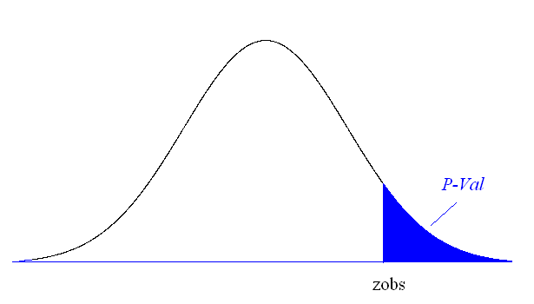
P-value
P-value answer the question: What is the probability of the observed test statistic … when H₀ is true?
P-value - measure of strength of evidence sample data provides against the null hypothesis:
Smaller P-values provide stronger and stronger evidence against H₀
Small P-value ⇒ strong evidence

Slide 65
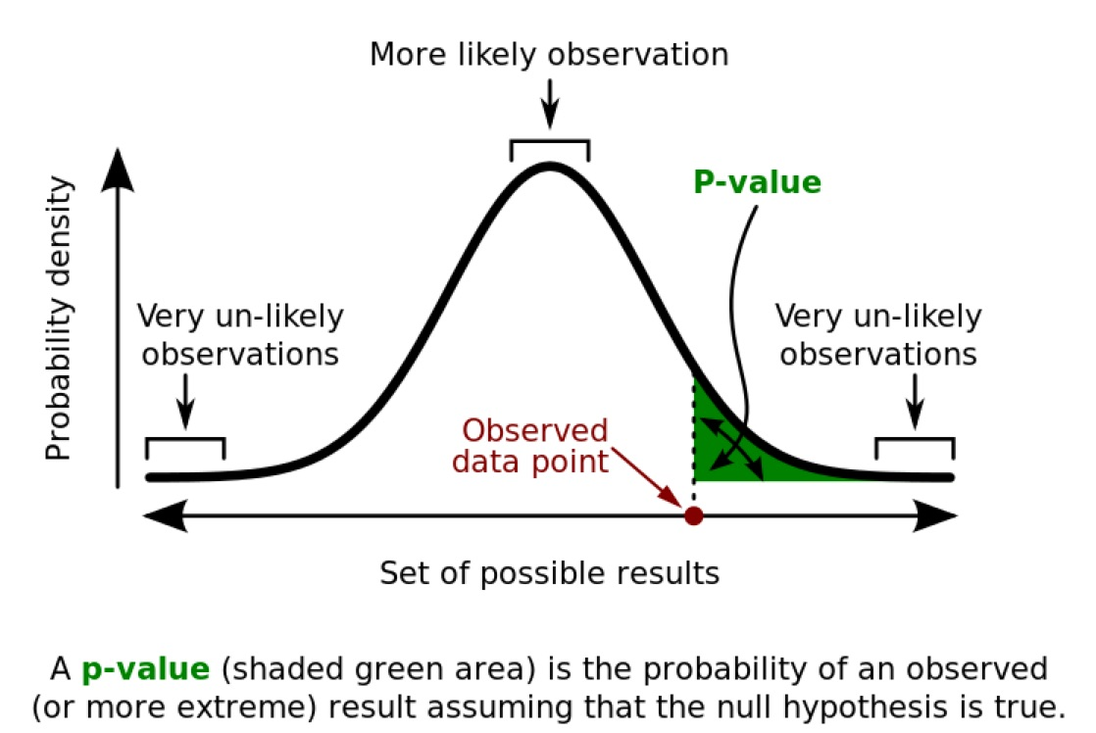
P-Values

Slide 66
Statistical Power
Probability of rejecting a null hypothesis that is, in fact, false (Williams, 1986, p. 67).
Probability of finding relationships or differences that in fact exist (Cohen, 1988).
Power is the probability of rejecting the null hypothesis if the alternative hypothesis is true.
Power = 1-β = P( reject H₀ | H₁ true )
A prospective power analysis is used before collecting data, to consider design sensitivity .
A retrospective power analysis is used in order to know whether the studies you are interpreting were well enough designed.

Slide 67
Calculating Power
Step 1: Determine information needed to calculate power
Population mean, population standard deviation, sample mean, sample size, standard error (based on sample size)
Step 2: Determine critical value
Step 3: Calculate power: the percentage of the distribution of the means for population 2 that falls above the critical value

Slide 68
Factors Effecting Statistical Power
Sample size
↑ N → power ↑
Variation in the outcome (σ²)
↓ σ² → power ↑
Significance level (α)
↑ α → power ↑
Difference (effect) to be detected (δ)
↑ δ → power ↑
One-tailed vs. two-tailed tests
Power greater in one-tailed tests than in comparable two-tailed tests

Slide 69
Approach for Testing Statistical Hypotheses
State objective of the test.
State statistical null and alternative hypotheses.
State significance level and assumptions.
Select appropriate test statistic.
Find rejection region of sampling distribution.
Collect sample data, check assumptions, calculate test statistic.
Make a decision and state conclusion.

Slide 70
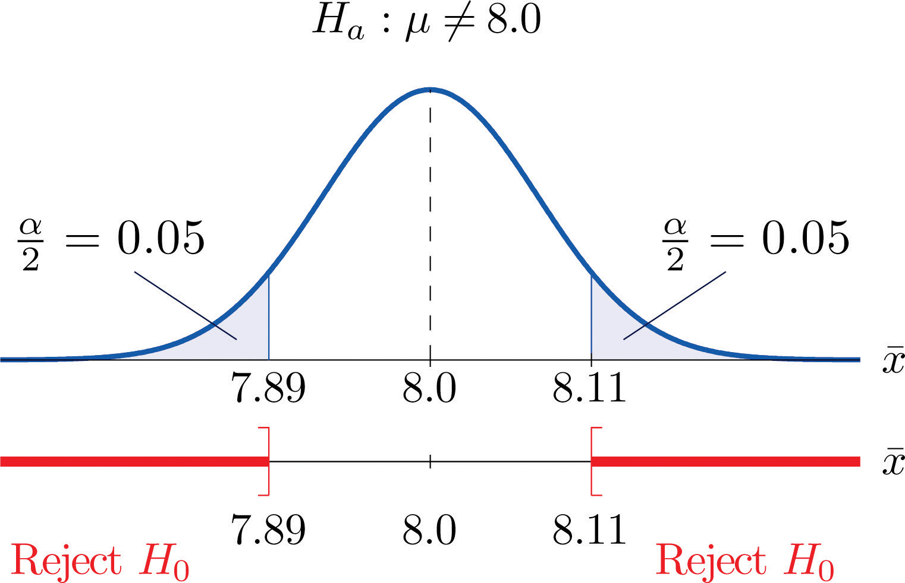
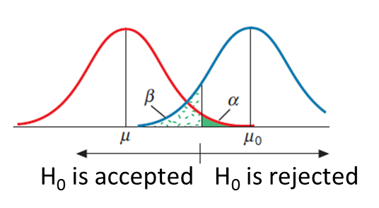
Making A Decision
Compare obtained value of test statistic with critical value or compare obtained p-value with pre-selected alpha value.
If obtained value of test statistic is in rejection region, reject null hypothesis.
If obtained value is not in rejection region, conclude that evidence from sample is not sufficient, and decision is fail to reject null hypothesis.

Slide 71
Adjusting for Multiple Comparisons
Multiple comparisons can increase alpha (probability of a Type I error).
Probability of a Type I error escalates with number of comparisons made in the study.
Experiment-wise alpha is computed as: 1-(1-alpha)n
Bonferoni-type procedure
Can be used to guard against alpha inflation
Splits alpha by the number of comparisons
Reducing alpha inflates beta

Slide 72
An Example
Unit | A | B
1 | 50 | 53
2 | 47 | 57
3 | 48 | 52
4 | 53 | 60
5 | 52 | 55
6 | 58 | 57
7 | 54 | 58
8 | 49 | 61
9 | 57 | 53
10 | 54 | 58
Do vegetable sources A and B differ in sodium content?
What are the null and alternative hypotheses?
Is this a one-tailed or two-tailed test?
What test statistic would you use?
What are the assumptions for the selected test statistic?
What is the first step in analyzing the data?

Slide 73
Analyzing the Data
data sodium;
infile datalines;
input source $ sodium @@;
datalines;
A 50 B 53 A 47 B 57 A 48 B 52 A 53 B 60 A 52 B 55
A 58 B 57 A 54 B 58 A 49 B 61 A 57 B 53 A 54 B 58;
run;
proc print data=sodium; run;
proc univariate data=sodium plots cibasic;
class source;
var sodium;
run;
ods graphics on;
proc ttest data=sodium;
class source;
var sodium;
run;
ods graphics off;

Slide 74
Results

Slide 75
Results

Slide 76
Results

Slide 77
Results

Slide 78
Let’s Practice…
Blood glucose levels for obese patients have a mean of 100 with a standard deviation of 15. A researcher thinks that a diet high in raw cornstarch will have a positive or negative effect on blood glucose levels. A sample of 30 patients who have tried the raw cornstarch diet have a mean glucose level of 140. Test the hypothesis that the raw cornstarch had an effect.
In a class, 49 students are given a blind taste test comparing Coke and Pepsi. Approximately half of the subjects are randomly chosen to receive Coke first and the rest randomly receive Pepsi first. Why? Coke was preferred 29 times. Is there evidence to suggest that students have a taste preference between Coke or Pepsi?

Slide 79
Let’s Practice…
The CEO of a large food company claims that 80 percent of his 1,000,000 customers are very satisfied with the service they receive. To test this claim, the company surveyed 100 customers, using simple random sampling. Among the sampled customers, 73 percent say they are very satisfied. Based on these findings, can we reject the CEO's hypothesis that 80% of the customers are very satisfied? Use a 0.05 level of significance.
Suppose the previous example is stated a little bit differently. Suppose the CEO claims that at least 80 percent of the company's 1,000,000 customers are very satisfied. Again, 100 customers are surveyed using simple random sampling. The result: 73 percent are very satisfied. Based on these results, should we accept or reject the CEO's hypothesis? Assume a significance level of 0.05.

Slide 80
Confidence Intervals

Slide 81
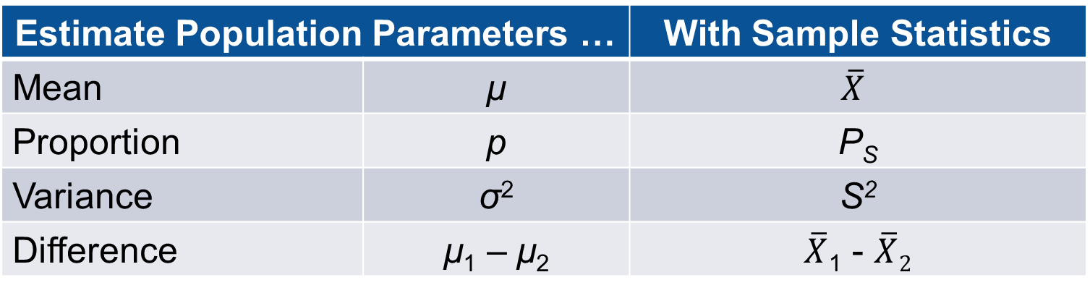
Point Estimates
Estimate Population Parameters … |  | With Sample Statistics
Mean | μ | $$\overline{X}$$
Proportion | p | P_{S}
Variance | σ² | S²
Difference | μ₁ – μ₂ | $\overline{X}$₁ - $\overline{X}2$
A point estimate of a parameter is the value of a statistic that estimates the value of the parameter.
A point estimate provides no information about the precision and reliability of estimation.
Point estimates do not tell us how close we are to the actual parameter.

Slide 82
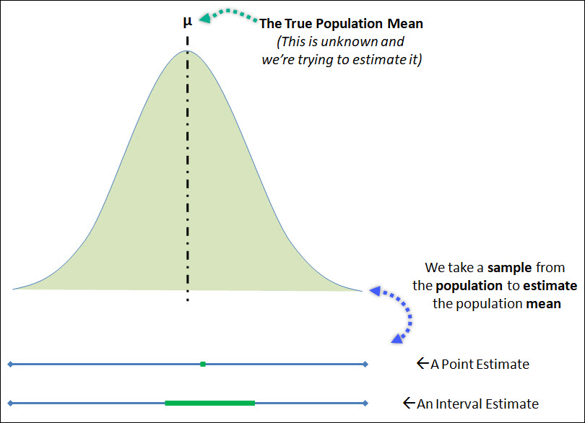
Interval Estimates
An interval estimate is interval, or range of values, used to estimate a population parameter.
Provides information about closeness to unknown population parameter.

Slide 83
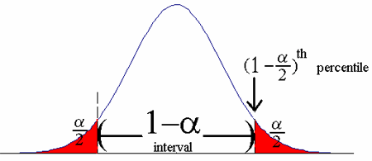
Confidence Intervals
Confidence interval estimate of parameter consists of interval of numbers along with probability that interval contains unknown parameter.
An interval of estimates that is likely to capture population value.
Level of confidence is probability that represents percentage of intervals that will contain true population parameter if large number of repeated samples are obtained.
Confidence level is denoted as 100(1-α)%.
Most frequently used confidence levels: 90%, 95%, 99%

Slide 84
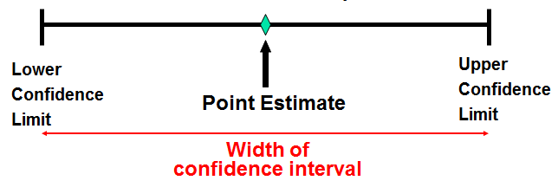
Width and Precision of CI
Precision of interval is conveyed by width of interval.
Every confidence interval is balance between certainty and precision.
Higher confidence level, more likely that true value of parameter being estimated lies within interval.
Very wide CI implies great deal of uncertainty.
Higher confidence ⬄ wider interval
Larger sample size (n) ⬄ narrower interval
For narrower CI, reduce confidence level or increase n

Slide 85
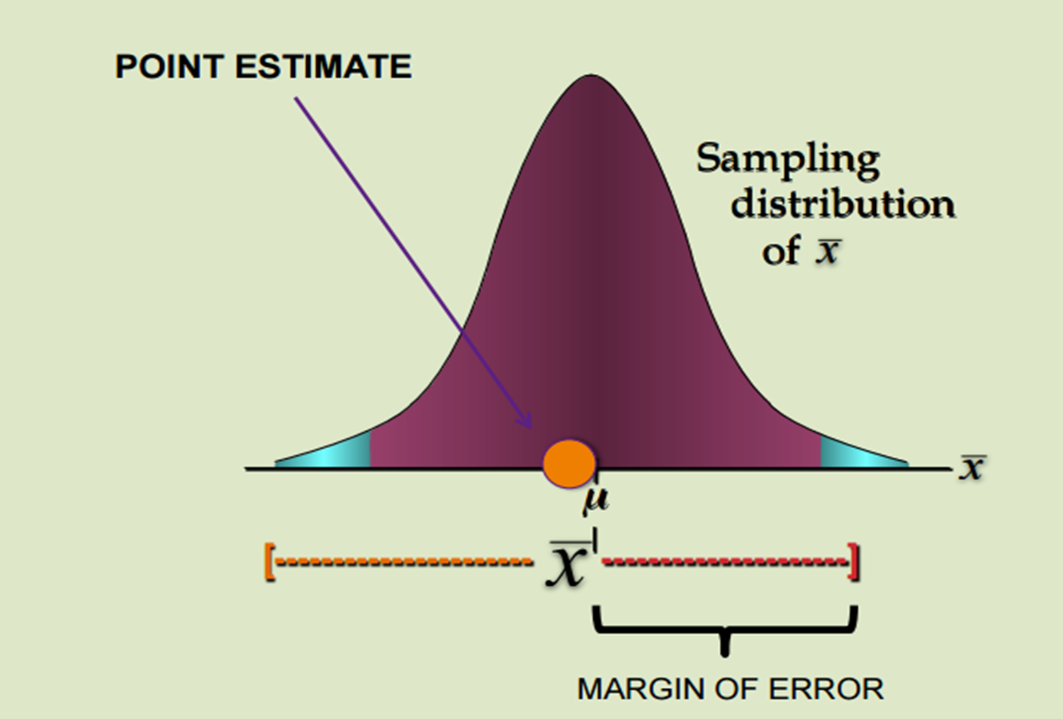
Margin of Error
Difference between point estimate and actual population parameter value is called sampling error.
Given a level of confidence, margin of error is the greatest possible distance between point estimate and actual population parameter.

Slide 86
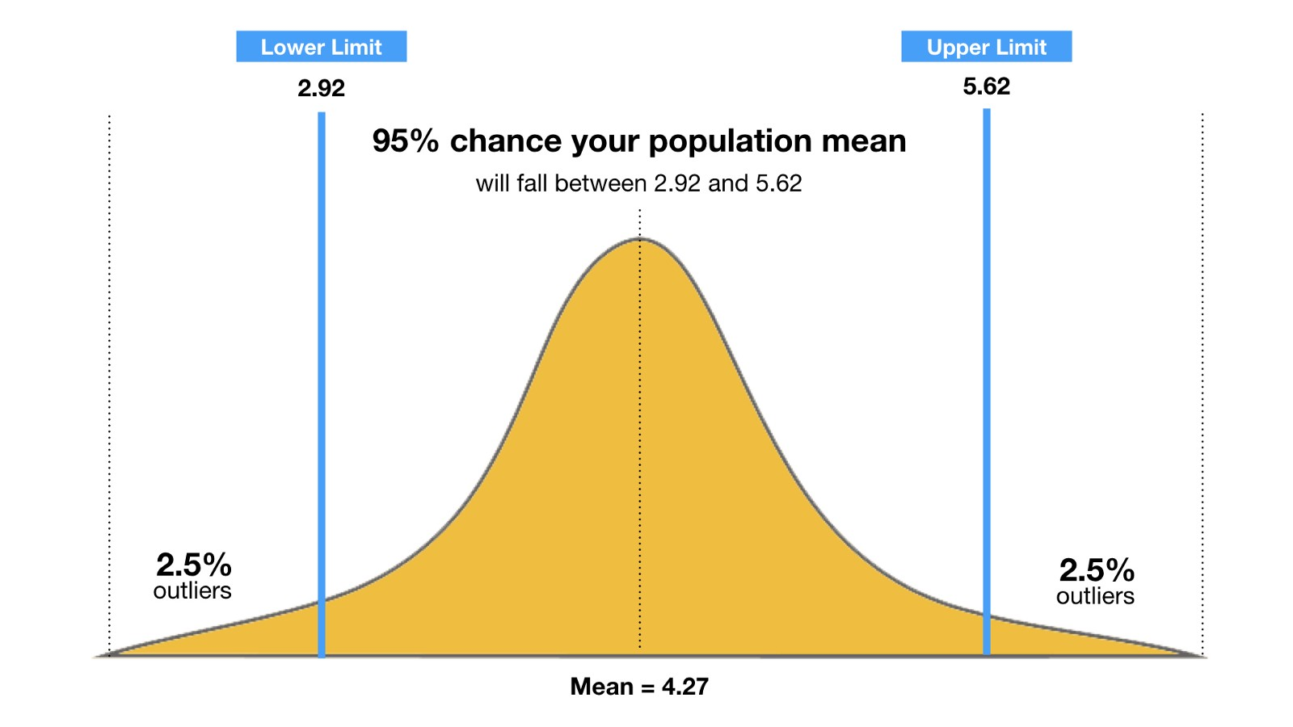
Interpreting Confidence Intervals
Confidence level of 100(1-α)% implies that 100(1-α)% of all samples include true value of parameter estimated.
In 95% of the samples we take, the true population parameter will be in the interval.
Also the same as saying we are 95% confident that the true population parameter will be in the interval.

Slide 87
Let’s Practice…
Example 1: Which interpretation is correct?
I am 90% confident that the interval (0.5,0.75) captures the true proportion of alumni that donate.
The probability that the interval (0.5, 0.75) captures the true proportion of alumni that donate is 0.90.
Example 2: Which interpretation is correct?
We are 99% certain that the interval (0.6, 0.99) contains the sample proportion of patients that have swine flu.
We are 99% certain that the interval (0.6,0.99) gives a range of reasonable values for the proportion of all patients having flu like symptoms actually have swine flu.

Slide 88
Constructing Confidence Intervals
General formula
Point Estimate is sample statistic estimating population parameter of interest
Critical Value is value based on sampling distribution of point estimate and desired confidence level
Standard Error is standard deviation of point estimate
Point Estimate + Margin of Error
Point Estimate + (Critical Value)(Standard Error)

Slide 89
Example – Constructing a Confidence Interval
Sample | CFU/mL
1 | 8.96
2 | 1.95
3 | 9.22
4 | 9.41
5 | 4.14
6 | 1.79
7 | 3.63
8 | 3.49
9 | 6.95
10 | 15
11 | 12
12 | 0.38
Pasteurization reduces amount of bacteria found in dairy products, such as milk.
Data represent counts of bacteria in pasteurized milk (in CFU/mL) for random sample of 12 pasteurized glasses of milk.
Construct a 95% confidence interval for the bacteria count.

Slide 90
Looking at the Data
data bacteria; infile datalines; input sample count; datalines; 1 8.96 2 1.95 3 9.22 4 9.41 5 4.14 6 1.79 7 3.63 8 3.49 9 6.95 10 15 11 12 12 0.38 ; run; proc print data=bacteria; run; proc univariate data=bacteria plots cibasic; var count; run;

Slide 91
Output

Slide 92
Impact of Outliers
Suppose a student miscalculated the amount of bacteria and recorded a result of 2.3 x 10⁵.
We include this value in the data set as 23.0.
What effect does this additional observation have on the 95% confidence interval?

Slide 93
Output

Slide 94
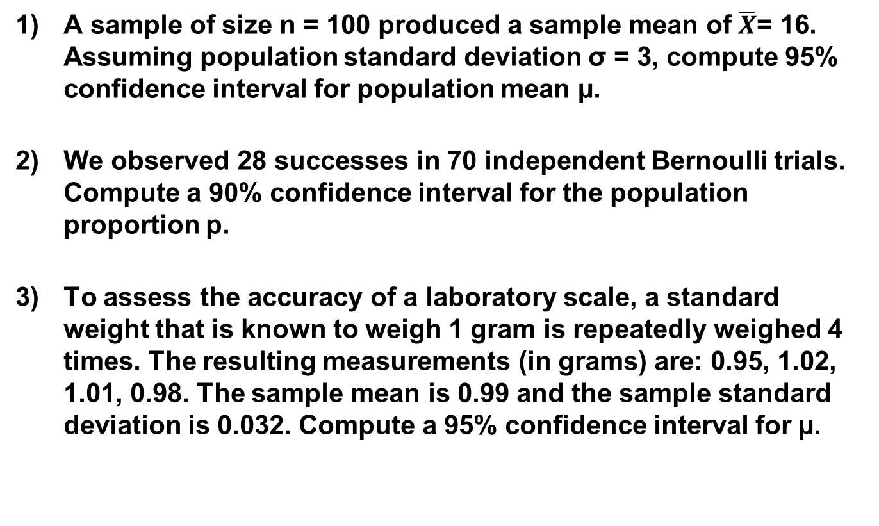
Let’s Practice…
A sample of size n = 100 produced a sample mean of $\overline{X}$= 16. Assuming population standard deviation σ = 3, compute 95% confidence interval for population mean µ.
We observed 28 successes in 70 independent Bernoulli trials. Compute a 90% confidence interval for the population proportion p.
To assess the accuracy of a laboratory scale, a standard weight that is known to weigh 1 gram is repeatedly weighed 4 times. The resulting measurements (in grams) are: 0.95, 1.02, 1.01, 0.98. The sample mean is 0.99 and the sample standard deviation is 0.032. Compute a 95% confidence interval for µ.

Slide 95
Let’s Practice…
You want to estimate with 95% confidence the difference between the mean length of the cobs of two varieties of sweet corn (A and B). You randomly sample 100 cobs of variety A and 110 cobs of variety B and find the mean length to be 8.5 inches and 7.5 inches, respectively. Prior research tells you that the population standard deviations for A and B are 0.35 and 0.45 inches, respectively.
Suppose a sample of 30 students are given a test. If the sample has a standard deviation of 12.23 points, find a 90% confidence interval for the population standard deviation.
Researchers want to find a 95% confidence interval for the difference in proportions of women with anemia in two countries. In country A, 840 of 2100 randomly sampled women are anemic. In country B, 323 of 1900 randomly sampled women are anemic.

Slide 96
Sample Size

Slide 97
How much data should we collect?
How many samples are needed to assure a given probability of detecting a statistically significant effect of a given magnitude if one truly exists?
If the sample is too small:
Study may fail to answer it’s research question.
Study may fail to detect important effects or associations.
Study may associate this effect or association imprecisely.
If the sample size is too large:
Study will be difficult and costly.
Time constraint.
Loss of accuracy.

Slide 98
How much data should we collect?
Sample size calculations are important to ensure that estimates are obtained with required precision or confidence.
Required for the following reasons:
To allow appropriate analysis
To provide desired level of accuracy
To allow validity to the significance test.
Examples:
a prevalence of 10% from a sample of size 20 ... 95%CI is 1% to 31%...
a prevalence of 10% from a sample of size 400 ... 95%CI is 7% to 13%

Slide 99
Calculating Sample Sizes
Depends on several factors:
Type I error (significance)
Type II error (power)
Difference trying to detect (effect size)
Standard deviation
Remember this is decided BEFORE the study!!!

Slide 100
What is Effect Size?
Effect size is a measure of the strength of the relationship between two variables in a population.
The bigger the size of the effect in the population, the easier it will be to find out.
Increasing sample size will make us more likely to find a statistically significant effect

Slide 101
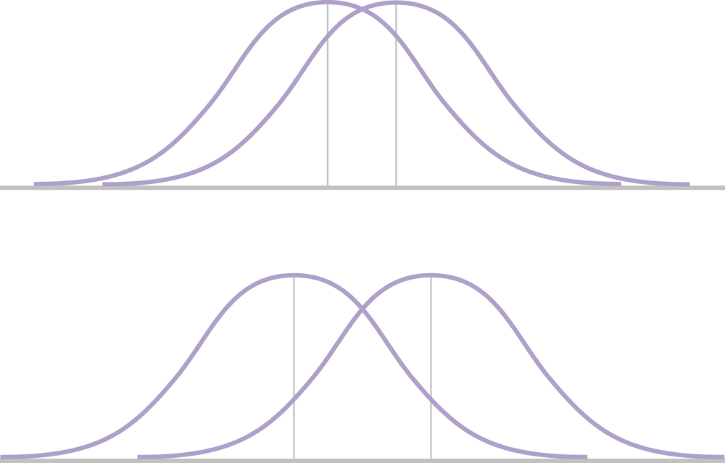
Which Effect is Bigger?

Slide 102
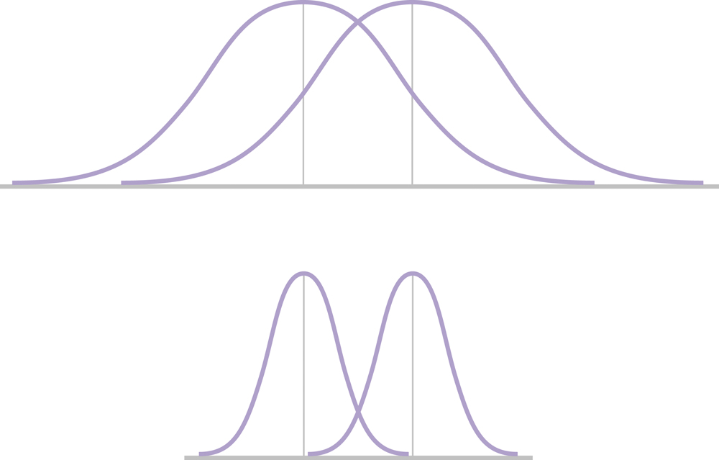
Which Effect is Bigger?

Slide 103
Measuring Effect Size
Because a significant effect does not necessarily mean a large effect, it is recommended that the hypothesis test be accompanied by a measure of the effect size.
We use Cohen=s d as a standardized measure of effect size.
Much like a z-score, Cohen=s d measures the size of the mean difference in terms of the standard deviation.

Slide 104
Determining Samples Sizes
The required sample size can be found to reach a desired margin of error (e) with a specified level of confidence (1 - α)
The margin of error is also called sampling error
Amount of imprecision in the estimate of the population parameter
Amount added and subtracted to the point estimate to form the confidence interval

Slide 105
To Determine Sample Size Need To Answer Following:
What is main purpose of study?
What is primary outcome measure?
Is it continuous or dichotomous outcome?
How will data be analyzed to detect difference?
How small difference is important to detect?
How much variability is in population?
What is desired α and β?
What is sample size allocation ratio?
What is anticipated drop out rate?

Slide 106
Sample Size Considerations
Degree of precision required between sample and population (confidence interval)
Less precision = smaller sample
Variability of the population
More homogenous population requires a smaller sample
More heterogeneous population, greater chance that sample may not adequately describe population→ inferences could be wrong.
Method of sampling
Stratified sample requires fewer cases for accuracy
Way in which results will be analyzed
Smaller sample puts limits on types of analyses possible

Slide 107
Sample Size Summary
Sample size very sensitive to values of Δ
Large N required for high power to detect small differences
Consider current knowledge and feasibility
Examine a range of values, i.e.:
for several Δ, power find required sample size
for several n, Δ find power
Often increase sample size to account for losses
Note: It’s always a good idea to consult a statistician.

Slide 108
An Example
Developing new laboratory test with at least 95% sensitivity and 80% specificity
Plan randomized, controlled study to test if meeting sensitivity and specificity targets
Want margin of error of 10%, a confidence level of 90% and a power of 90%.
What sample size is needed?
 | Test Hypotheses
Analytical Performance | Ho: Sensitivity rate = 0.95 Ha: Sensitivity rate < 0.95
 | Ho: Specificity rate = 0.80 Ha: Specificity rate < 0.80

Slide 109
SAS Code
proc power;
onesamplefreq test=z
method=normal
sides = L
nullproportion=0.95
proportion=0.9 0.85 0.8
alpha =0.05
power =0.9
ntotal=.;
run;
proc power;
onesamplefreq test=z
method=normal
sides = L
nullproportion=0.80
proportion=0.75 0.7
alpha =0.05
power =0.9
ntotal=.;
run;
proc power;
ods output plotcontent=plotdata;
onesamplefreq test=z
method=exact
sides = L
nullproportion=0.95
proportion=0.80 0.90
alpha =0.05
power =.
ntotal=40;
plot x = n min = 10 max = 300
step=1;
run;

Slide 110
Estimated Sample Sizes

Slide 111
Estimating Power for Given Sample Size

Slide 112
Life is about Trade-offs!
α=0.05, β= 0.1 (Power =90%)
Null Proportion = 0.95 |  |  | Null Proportion =0.80
Proportion | Power | N | Proportion | Power | N
0.90 | 0.900 | 221 | 0.75 | 0.900 | 589
0.85 | 0.901 | 67 | 0.70 | 0.901 | 156
0.80 | 0.902 | 34
α=0.05, β= 0.2 (Power =80%)
Null Proportion = 0.95 |  |  | Null Proportion =0.80
Proportion | Power | N | Proportion | Power | N
0.90 | 0.801 | 150 | 0.75 | 0.800 | 419
0.85 | 0.803 | 44 | 0.70 | 0.801 | 109
0.80 | 0.806 | 22

Slide 113
Let’s Practice…
If σ = 45, what sample size is needed to estimate the mean within ± 5 with 90% confidence?
How large a sample would be necessary to estimate the true proportion of defectives in a large population within ±3%, with 95% confidence? Assume a pilot sample yields p = 0.12.
How large a sample is needed for a one-sample z test with 90% power and α = 0.05 (two-tailed) when σ = 40? Let H₀: μ = 170 and H_{a}: μ = 190.

Slide 114
Let’s Practice…
Suppose the prevalence of brucella infection is 2% and the absolute difference to be detected is 0.25% with a 95% confidence, what is the sample size required?
Want to know mean percentage of butterfat in milk produced by a farm by sampling multiple loads of milk. Previous records indicate average percent butterfat in milk is 3.35 and standard deviation among loads is 0.15. Hope to detect a change of the percent butterfat in milk to 3.40 with a power 0.8. How many loads do we need to sample so that the margin of error for a 90% confidence interval of the mean percent butterfat is no more than 0.06?

Slide 115

Questions?

